Slide 1
Ann-Britt Enochsson Karlstad University
Digital Literacy as a Prerequisite in Teacher Education

Slide 2
Background
2012, new secondary teacher program at Karlstad University
mapping the students’ digital competencies related to the internet and their expectations as part of a larger project
(Enochsson & Buskqvist, 2012)
Notes:
The reason to study internet skills and uses, was that we also launched an online program

Slide 3
Questionnaire 2012
Distributed to all subject teacher-students beginning in 2012
Subjects
Biology, Civics, English, History, Mathematics, Spanish and Swedish.
61 out of 154 answered the questionnaire – return rate 40 %....?
(Enochsson & Buskqvist, 2012)
Notes:
33 av 154 gick ut nu. Det är 21%

Slide 4
Experiences of internet activities – 2012 cohort
Differs from the average Swedish person of the same age
More Facebook (lurking), but very low activity regarding images, twitter, wikis etc….
Conclusion: More traditional than others
(Enochsson & Buskqvist, 2012)

Slide 5
Digital technology in their future profession
Regarded as very important
They believe their future students know a lot about digital technology
There is a lack of role models

Slide 6
Aim
To compare 2012 and 2016 cohort regarding digital competencies and experiences related to the internet when entering secondary teacher education
Research questions
Are there any trends and/or changes over time
1. between the two cohorts
2. compared to the average Swedish citizen of the same age

Slide 7
Questionnaire 2016
All subject teacher-students beginning in 2016
Subjects
Biology, Chemistry, Civics, English, Geography, History, Mathematics, Music, Natural science, Physics, Religion, Spanish, Sports, and Swedish.
63 out of 191 answered the questionnaire – return rate 33 %.
....or 83%?

Slide 8
Changes between cohorts
More students have their own smartphone 2016 ***
More students have their own tablet 2016 ***
Comment: The teacher students are catching up
*** = p<.001
Notes:
Chi-square tests (yes or No)
p< .oo1
Smartphones teacher students 2012: 82,8%, 2016: 96,8% (swedes in this age group: 81 - 98%)
Tablets 2012: 9,4%, 2016: 56,5% (swedes 20-50-39% for the age group [egen])

Slide 9
Changes between cohorts
More students use digital media for private purposes 2016 **
*** = p<.001
Notes:
T-tests have been used and it has first been checked for Levene’s Equality of variances test, but p is so small so there is no difference in practice
FB, 2012: 10% dagligen, 2016 3,2% dagligen. I befolkningen är det denna grupp som är största gruppen FB-användare. Användargraden ligger på samma nivå, men att posta ligger lägre ... eller kanske inte?
I befolkningen är kvinnor de största användarna, här är övervägande kvinnor
Internet use has increased in the population

Slide 10
Changes between cohorts
More students 2016
listen to music online **
listen to pods ***
watch TV streaming * as well “play” **
Fewer students download films 2016 ***
** = p<.010
Notes:
Musik: svensken i dessa åldrar runt 90%, dessa 84% närmar sig
poddar har inte varit vanligt i Sverige, ligger ganska lika genomsnittet, men denna åldersgrupp lyssnar dubbelt så mycket som genomsnittssvensken. Lärarstudenterna ligger efter.
play-tjänster något lägre, men ganska lika
Fildelningen ligger kvar på 40% i riket för dessa åldrar, men bland studenterna har det minskat från 30% till 10%

Slide 11
Changes between cohorts
Fewer students have their own blog 2016 ***
More students post their status on Facebook 2016 ***
* = p<.05
Notes:
less than 10% have their own blog in this age group in Sweden (stable number), while about 3% of the students do it.
Comment: While status update in social media has become less common in general, this group has increased their activity

Slide 12
Changes between cohorts
More students 2016
use Google drive (docs) ***
collaborate in Google drive/docs ***
shop online *
* = p<.05
Notes:
Molntjänster inte inkluderade i nationella undersökningen

Slide 13
Activities on the rise
Notes:
Most activities have increased in the population
All activities that were possible to compare, fit in one of these three groups.

Slide 14
”Saturated” activities
Notes:
Also having a smartphone
Internetuse in general

Slide 15
Activities which already had its peak
Notes:
tablets
twitter
blog

Slide 16
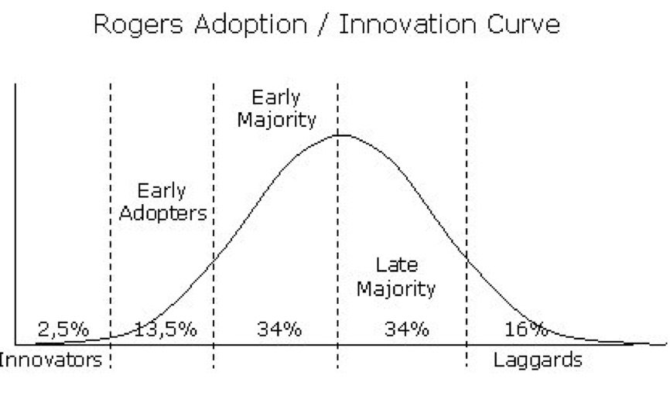
Late majority...?
Notes:
No early adopters
Is it acceptable
Teacher education has a great responsability
Diffusion of innovations is a theory that seeks to explain how, why, and at what rate new ideas and technology spread. Everett Rogers, a professor of communication studies, popularized the theory in his book Diffusion of Innovations; the book was first published in 1962, and is now in its fifth edition (2003).^{[1]} Rogers argues that diffusion is the process by which an innovation is communicated over time among the participants in a social system. The origins of the diffusion of innovations theory are varied and span multiple disciplines.
Rogers proposes that four main elements influence the spread of a new idea: the innovation itself, communication channels, time, and a social system. This process relies heavily on human capital. The innovation must be widely adopted in order to self-sustain. Within the rate of adoption, there is a point at which an innovation reaches critical mass.
The categories of adopters are innovators, early adopters, early majority, late majority, and laggards.^{[2]} Diffusion manifests itself in different ways and is highly subject to the type of adopters and innovation-decision process. The criterion for the adopter categorization is innovativeness, defined as the degree to which an individual adopts a new idea.

Slide 17
Digital technology in their future profession (2016 cohort)
Regarded as very important
They believe their future students know a lot about digital technology
There is a lack of role models – in most subjects. Mathematics is an exception.

Slide 18
What does it mean?
a challenge for teacher education?

Slide 19
Thank you for listening!
ann-britt.enochsson@kau.se

